Slide 1
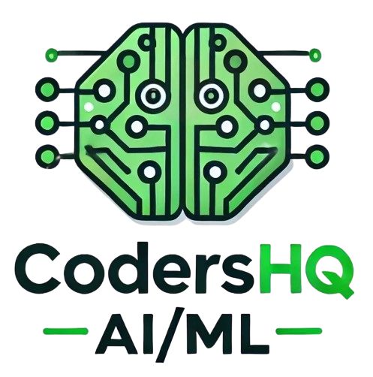




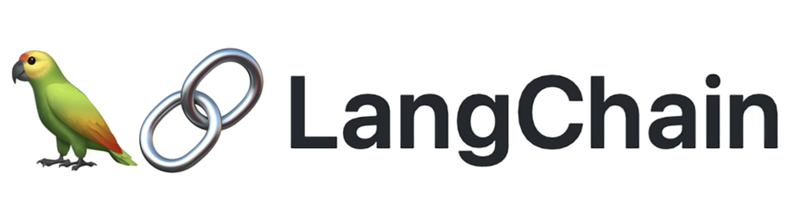

Building Intelligent Chatbot
Speaker: Isham Rashik
AI Engineer at KNAI / AI Community lead under CodersHQ

Slide 2
Introduction about myself
Brought up in UAE - residing more than 27 years - from primary school till completing Masters.
BEng. Electrical And Electronic Engineer and MBA in Finance and Operations
Worked in multiple sectors - Education, Finance, Telecom, Media, and Research & Development
Currently working as AI Engineer working at KNAI.
Involved in both Classical Machine Learning and Generative AI projects
Overall more than 6 years in the field of State of the Art Technology
Top Voice in Machine Learning, Data Science and Artificial Intelligence on Linkedin from August 2023 till February 2024
Currently also AI Community lead under CodersHQ and one of the Co-Founders of Launchpad.

Slide 3









Slide 4
Today’s agenda
Introduction to key technologies
Build non-persistent conversational chatbot
Integrate with database to build persistent conversational chatbot
What is chatbot and types of chatbot

Slide 5
What is Chatbot?
It is a personal virtual assistant that is build for helping us to get done with task
It can help ranging from making pizza order customer till helping using to do research (use of ai agents)
It can be either in the form of text or voice
Platforms – any websites, WhatsApp, Discord, Slack, and now ChatGPT, Claude etc

Slide 6
Types of Chatbots
Aspect | Rule-Based Chatbots | AI-Powered Chatbots
Functionality | Follow predefined rules and decision trees | Use machine learning and natural language processing
Flexibility | Limited to programmed scenarios | Can handle a wide range of queries and conversations
Understanding | Keyword-based matching | Can understand context and intent
Learning | Does not learn from interactions | Can improve over time with more data
Complexity | Simpler to develop initially | More complex to develop and train
Customization | Requires manual updates to rules | Can adapt to new situations without reprogramming
Languages | Limited to few languages | Multilingual - Upto 50 languages or more
Scalability | Limited by the number of rules | Can scale to handle diverse queries
Human-like Interaction | Less natural conversation flow | More natural human-like conversations

Slide 7

Key Technologies
Access to Large Language Models through service providers
Langchain Library
Firebase – Firestore Database

Slide 8
Why use Large Language Models to build Chatbots
Contextual Awareness
Reduces extra manual efforts – handcrafted heuristic rules
Versatility and Scalability
Continuous Learning and Improvement
Notes:
Example dataset: https://huggingface.co/datasets/HuggingFaceH4/ultrachat_200k

Slide 9
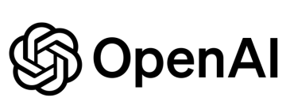



Some of the LLM Service Providers

Slide 10
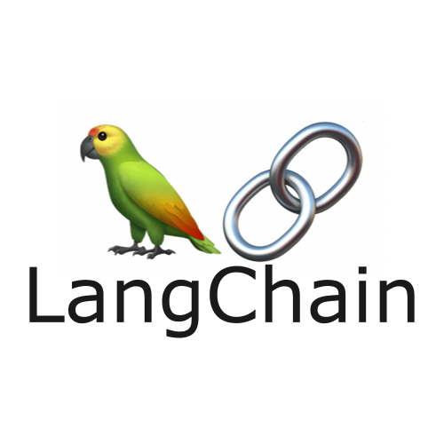
Introduction to LangChain
There are many LLM service providers such as OpenAI, HuggingFace, Claude etc
LangChain is a library that acts as wrapper to develop LLM powered apps
Aimed to save writing us complex algorithms and therefore speed up development time
There are several built-in modules – Text Summarization, Entity Extraction, Conversational Chatbot
Modular and flexible
We will be using it to develop our Chatbot

Slide 11

What is Firebase?
Firebase is a platform developed for creating mobile and web applications
Initially an independent company in 2011
Later was acquired by Google in 2014
Some of the Key Features as follows:
Realtime Database
Firestore Database
Machine Learning
Storage
For this project, we will use Firestore Database

Slide 12

Open-source Python library that makes it easy to create and share machine learning demos and applications
Initially independent company later acquired by HuggingFace
Allows users to quickly build interactive web interfaces for machine learning models
Particularly useful for showcasing the capabilities of models in areas like natural language processing, computer vision, and more

Slide 13

Project Setup on Firebase
Create environment and install dependencies
Create new project on Firebase
Notes:
1. Make sure you have signed in to your Google account. Go to https://console.firebase.google.com/.
2. If this is your first project, click "Get started with a Firebase project." Otherwise, click "Create a Project."
3. Under Project Settings, click on "Service accounts," then click "Generate new private key." This will download a JSON file.
4. Place the private key JSON file in the root directory and set the location of the file as GOOGLE_APPLICATION_CREDENTIALS in the .env file.
5. Create a Firestore database in your Firebase project. This action will automatically enable you to use the Firebase API.
6. Under Project Settings, copy the project ID and set it as PROJECT_ID in the .env file.

Slide 14

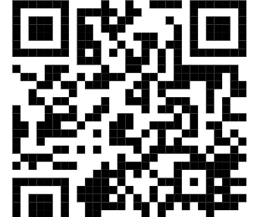
Scan QR Code for the materials
Link: https://drive.google.com/drive/folders/1YSEjciTUt8XnyGrXlAJYvF3ChZNHv0aM

Slide 15
What to do next?
Review and practice the concepts learned so far
Experiment with different Large Language Models (LLMs) to compare effectiveness
Implement these concepts at work to fulfill specific requirements
Explore use cases across various sectors: E-commerce, Customer Service, Legal, and Medical
Integrate Retrieval-Augmented Generation (RAG) to enhance the bot's capabilities for each application

Slide 16
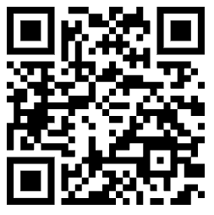
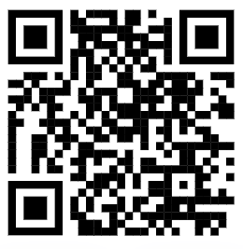
Feel Free to Connect with me 😊 Scan QR Code
Linkedin Profile: https://www.linkedin.com/in/isham-rashik-5a547711b/
Github link: https://github.com/di37

